Slide 1

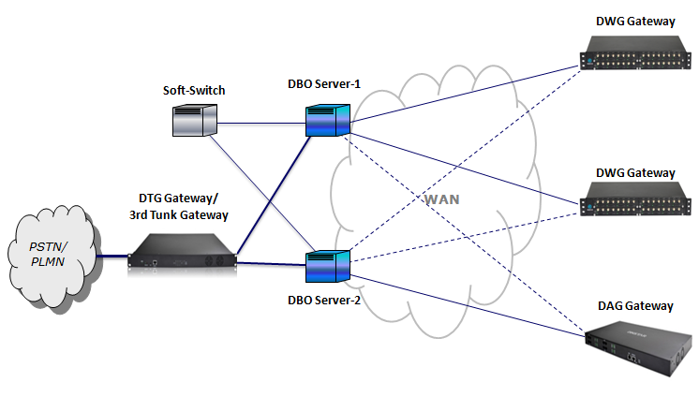

Focus Innovation Transformation
DBO Server
DBO Server uses DINSTAR Dynamic Bandwidth Optimization technologies, supports DWG/DAG series products, it can significantly reduce the cost of VoIP bandwidth, and improve service security and peer-to-peer VoIP Qos.
DBO Server Application
The Gateway to VoIP World
Notes:
1

Slide 2


Decade Focused
Creates the High-quality Products
Key Features
Dynamic Bandwidth Optimization, smart transmitting engine against network bandwidth/jitter/loss changes
VoIP Bandwidth Saving, up to 4:1 compression( 512K bit/s supports 32 channels )
VoIP QOS Enhancement, better voice quality upon same network
Multi-Path Protection, improve service security upon complex network
SIP Encryption, independent and encrypted tunnel for SIP packet
RTP Encryption, independent and encrypted tunnel for RTP packet
Up to 3,200 channels in one server( based on hardware performance )
Inside DBO Agent in DWG/DAG series products, no additional hardware
Full compatibility with 3rd Soft-Switch and Trunk Gateway products
*Inside DBO Agent in DTG series products, no DBO Server required if using DTG and DWG/DAG together
Notes: “*”marked feature will be supported in future releases.
The Gateway to VoIP World
Notes:
2

